Slide 1
The Gap Statistic & Longitudinal Clustering
UIUC ECON 490: Applied Machine Learning in Economics

Slide 2
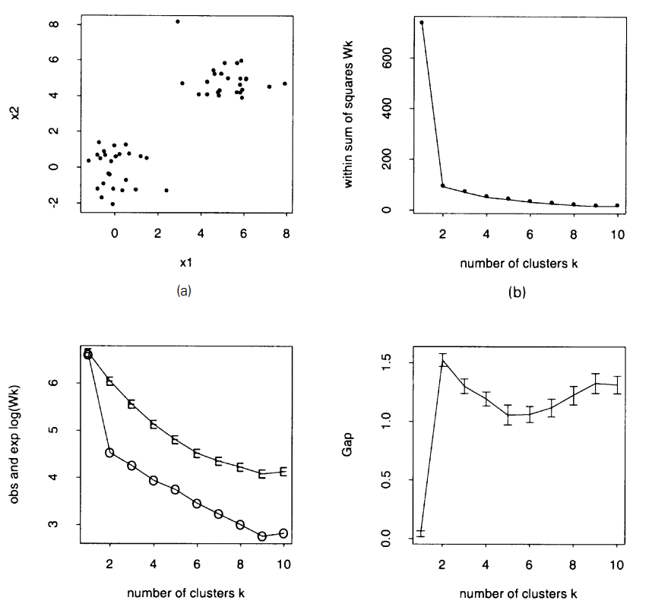
Gap Statistic
Tibshirani, Walther, & Hastie (2001) Estimating the number of clusters in a data set via the gap statistic

Slide 3
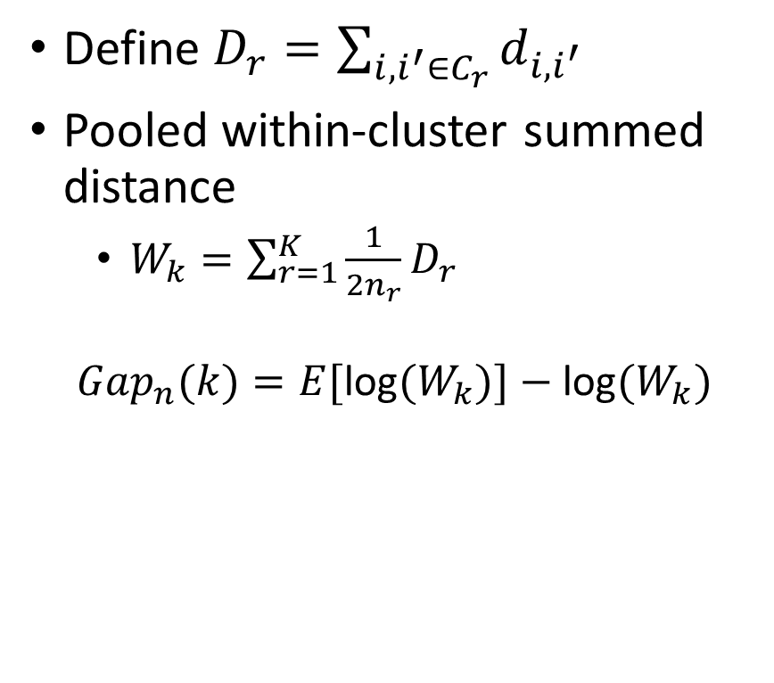
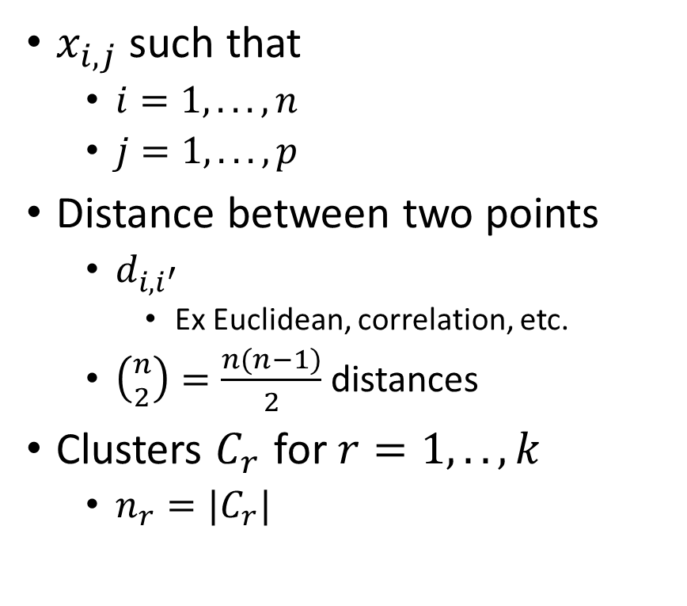
Gap Statistic – Theory
$x_{i,j}$ such that
$i=1,...,n$
$j=1,...,p$
Distance between two points
$d_{i,i^{′}}$
Ex Euclidean, correlation, etc.
$\left({n \atop 2}\right)=\frac{n(n−1)}{2}$ distances
Clusters $C_{r}$ for $r=1,..,k$
$n_{r}=|C_{r}|$
Define $D_{r}=\sum_{i,i^{′}∈C_{r}}^{​}{d_{i,i^{′}}}$
Pooled within-cluster summed distance
$W_{k}=\sum_{r=1}^{K}{\frac{1}{2n_{r}}}D_{r}$
$$Gap_{n}(k)=E[\text{log}(W_{k})]−\text{log}(W_{k})$$

Slide 4
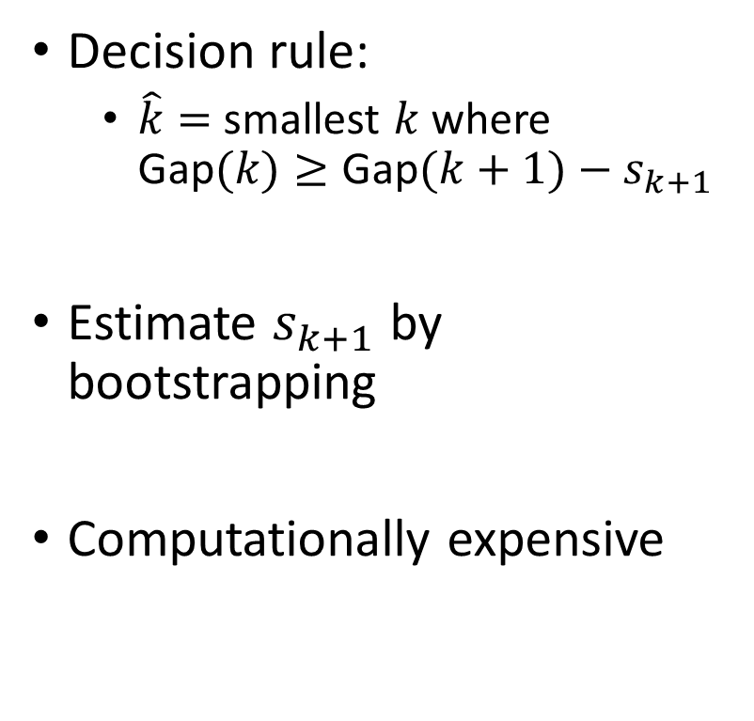
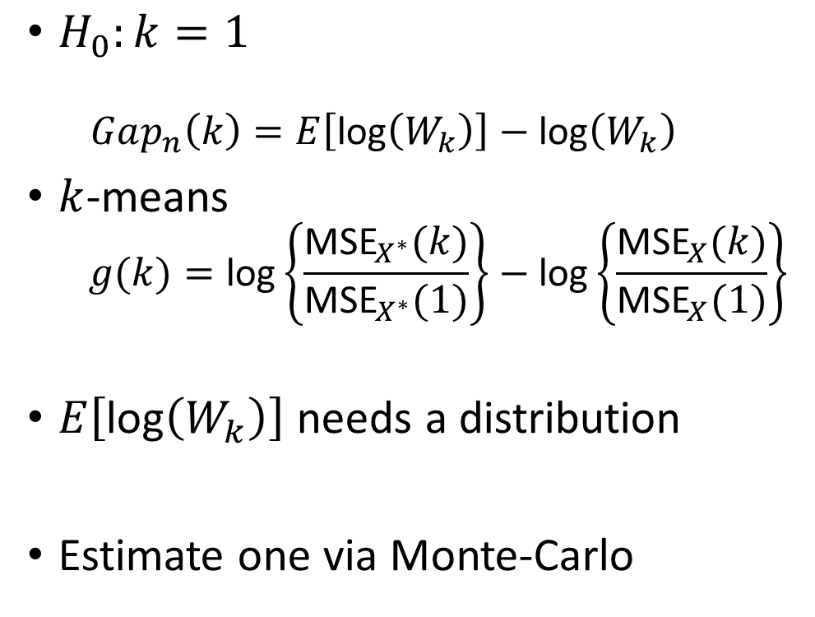
Gap Statistic – Intuition
$H_{0}:k=1$
$$Gap_{n}\left(k\right)=E\left[\text{log}\left(W_{k}\right)\right]−\text{log}\left(W_{k}\right)$$
$k$-means
$$g(k)=\text{log}\left\{\frac{{\text{MSE}}_{X^{∗}}(k)}{{\text{MSE}}_{X^{∗}}(1)}\right\}−\text{log}\left\{\frac{{\text{MSE}}_{X}(k)}{{\text{MSE}}_{X}(1)}\right\}$$
$E\left[\text{log}\left(W_{k}\right)\right]$ needs a distribution
Estimate one via Monte-Carlo
Decision rule:
$\hat{k}=$ smallest $k$ where $\text{Gap}(k)≥\text{Gap}(k+1)−s_{k+1}$
Estimate $s_{k+1}$ by bootstrapping
Computationally expensive

Slide 5
Longitudinal Clustering
Looking at features differently

Slide 6
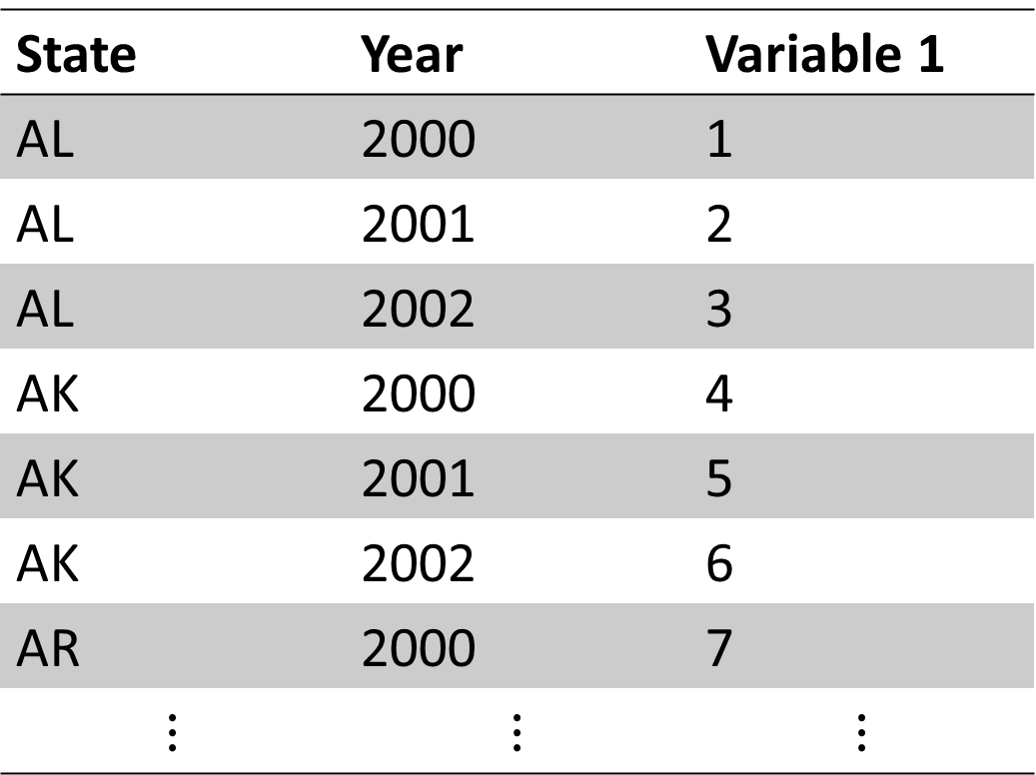
Properly Formatted Data (long)
State | Year | Variable 1
AL | 2000 | 1
AL | 2001 | 2
AL | 2002 | 3
AK | 2000 | 4
AK | 2001 | 5
AK | 2002 | 6
AR | 2000 | 7
$$⋮$$ | $$⋮$$ | $$⋮$$

Slide 7
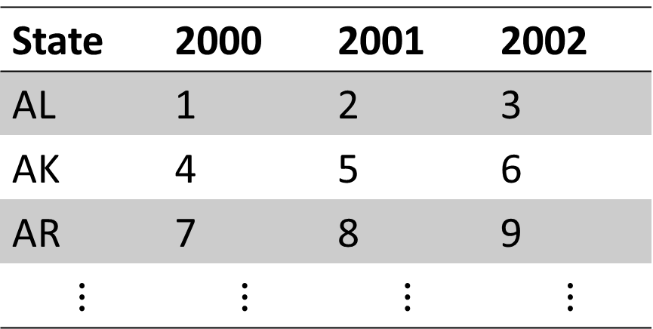
Data Formatted for Clustering (wide)
State | 2000 | 2001 | 2002
AL | 1 | 2 | 3
AK | 4 | 5 | 6
AR | 7 | 8 | 9
$$⋮$$ | $$⋮$$ | $$⋮$$ | $$⋮$$

Slide 8
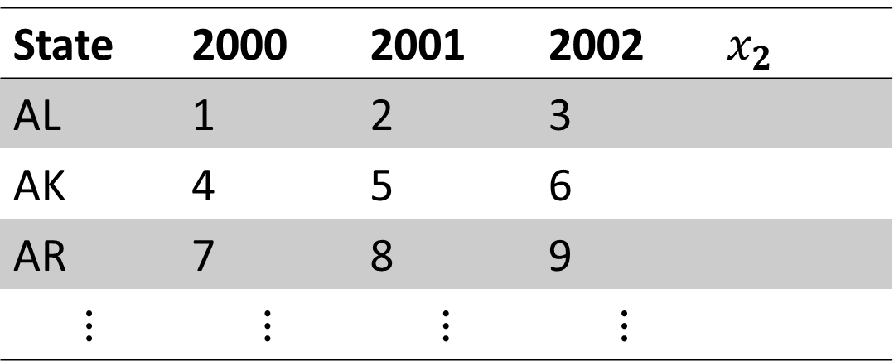
Data Formatted for Clustering (wide)
State | 2000 | 2001 | 2002 | $x_{2}$
AL | 1 | 2 | 3
AK | 4 | 5 | 6
AR | 7 | 8 | 9
$$⋮$$ | $$⋮$$ | $$⋮$$ | $$⋮$$

Slide 9
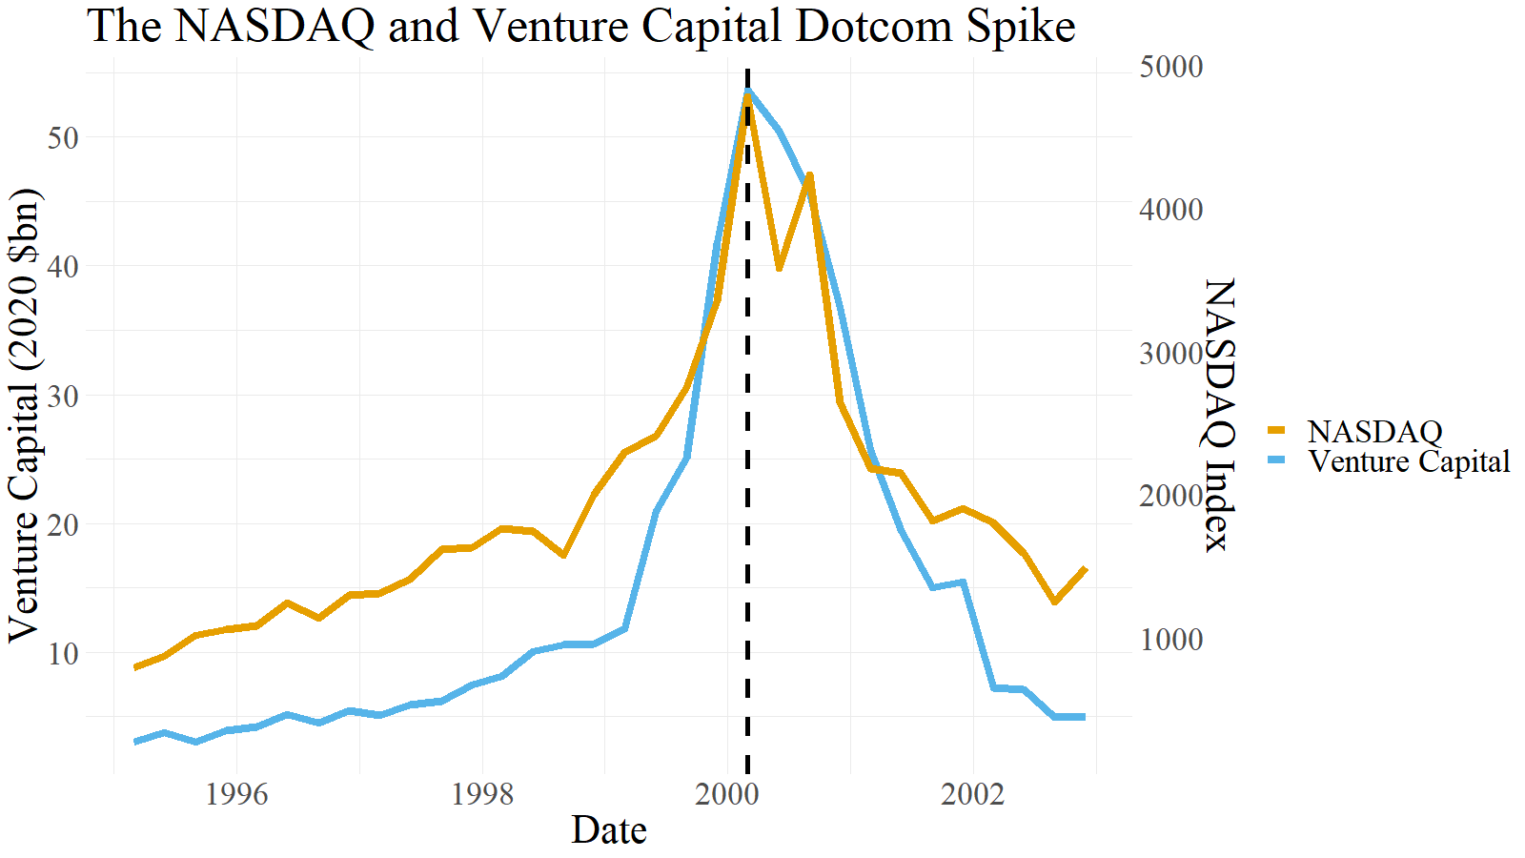
Application 1/3 – Finance

Slide 10
Application 2/3 – LR Occupational Trends
Autor & Salomons (2019) New Frontiers: The Evolution of New Work
Period | Increase | Decrease
1950-1960 | Clerical, administrative
1960-1970 | Clerical, administrative, sales | Production
1970-1980 | Office work
1980-1990 | Professional | Office, low-ed “masculine”
1990-2000 | Professional, technician | Office, low-ed “masculine”
2000-2015 | Professional, “wealth work” | Office, low-ed ”masculine

Slide 11
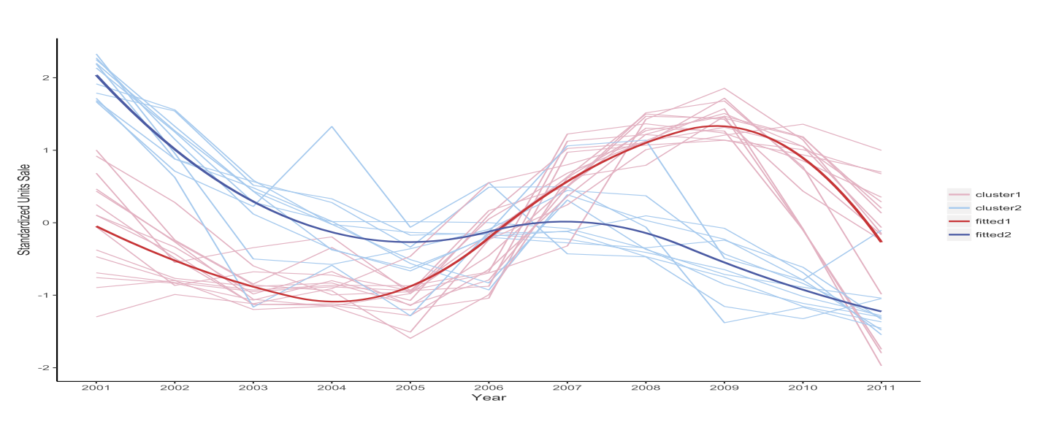
Application 3/3 – Great Recession Purchases
Cluster 1 – beer/ale/alcoholic, coffee, cold cereal, frozen dinners/entrees, frozen pizza, hotdogs, mayonnaise, milk, mustard/ketchup, peanut butter, salty snacks, soup
Cluster 2 –blades, cigarettes, deodorant, diapers, facial tissue, paper towels, photography supplies, razors, shampoo, toilet tissue, and toothpaste

Slide 12
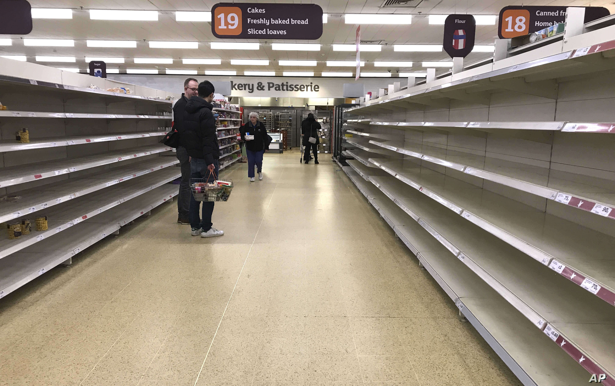
Application 3/3 – COVID Purchases

Slide 13
To Do
Next time…
GitHub!
Download Atom: https://atom.io/
Download git: https://git-scm.com/downloads
Create a GitHub account https://github.com/join
Recommend using not your university email (i.e. personal)
Due Friday 11:59pm – Preliminary Results

Slide 14

ENJOY BREAK! BE SAFE! HAVE FUN!
This Photo by Unknown Author is licensed under CC BY-NC

